Slide 1


Project Report on Micro Credit Loan Defaulters
By:
Roshan Kumar Verma

Slide 2
Introduction
A Microfinance Institution (MFI) is an organization that offers financial services to low income populations. MFS becomes very useful when targeting especially the unbanked poor families living in remote areas with not much sources of income. The Microfinance services (MFS) provided by MFI are Group Loans, Agricultural Loans, Individual Business Loans and so on.
Many microfinance institutions (MFI), experts and donors are supporting the idea of using mobile financial services (MFS) which they feel are more convenient and efficient, and cost saving, than the traditional high-touch model used since long for the purpose of delivering microfinance services. Though, the MFI industry is primarily focusing on low income families and are very useful in such areas, the implementation of MFS has been uneven with both significant challenges and successes.
Today, microfinance is widely accepted as a poverty-reduction tool, representing $70 billion in outstanding loans and a global outreach of 200 million clients.

Slide 3
Problem Statement
We are working with one such client that is in Telecom Industry. They are a fixed wireless telecommunications network provider. They have launched various products and have developed its business and organization based on the budget operator model, offering better products at Lower Prices to all value conscious customers through a strategy of disruptive innovation that focuses on the subscriber .
They understand the importance of communication and how it affects a person’s life, thus, focusing on providing their services and products to low income families and poor customers that can help them in the need of hour.
They are collaborating with an MFI to provide micro-credit on mobile balances to be paid back in 5 days. The Consumer is believed to be defaulter if he deviates from the path of paying back the loaned amount within the time duration of 5 days. For the loan amount of 5 (in Indonesian Rupiah), payback amount should be 6 (in Indonesian Rupiah), while, for the loan amount of 10 (in Indonesian Rupiah), the payback amount should be 12 (in Indonesian Rupiah).

Slide 4
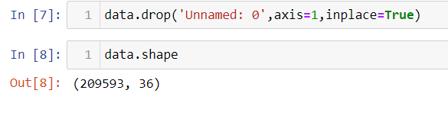
Data Sources and their formats
The data is been provided by one of our client from telecom industry they are a fixed wireless telecommunications network provider. They have launched various products and have developed its business and organization based on the budget operator model, offering better products at Lower Prices to all value conscious customers through a strategy of disruptive innovation that focuses on the subscriber.
The data is been given by Indonesian telecom company, they given data to us in CSV file, with data description file in excel format, they also provide the problem statement what they want what they need from us.
Below is the shape of the data which is provided to us .

Slide 5
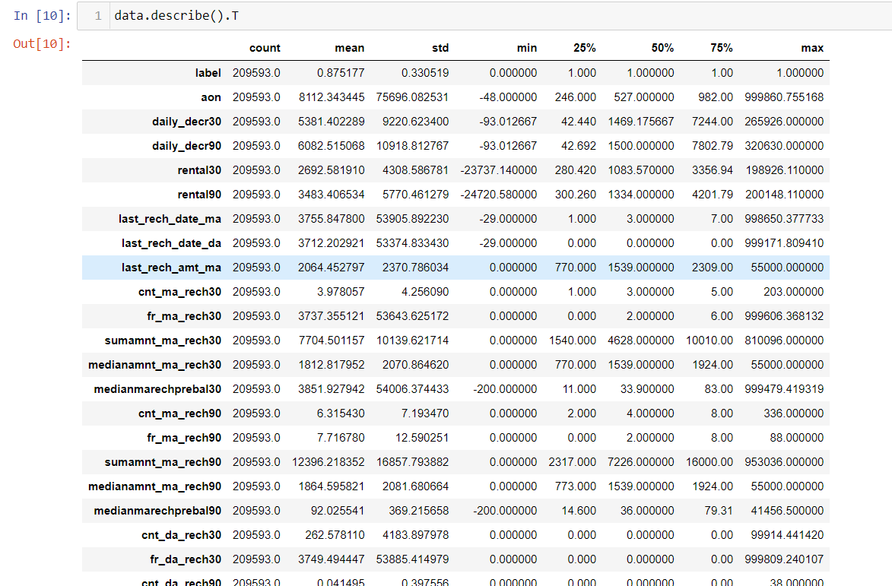
Data Description
Summary statistics shows all the statistics of our dataset i.e. mean, median and other calculation. Mean is greater than median in all the columns so aur data is right skewed. The difference between 75% and maximum is higher that's why outliers are removed which needs to be removed. The pdate column tells the date when the data is collect. It contains only three month data. msidn is a mobile number of user and mobile number is unique for every customers. There are only 186243 unique number out of 209593 so rest of the data is duplicates entry so we have to remove those entry.

Slide 6

Data Visualizations

Slide 7
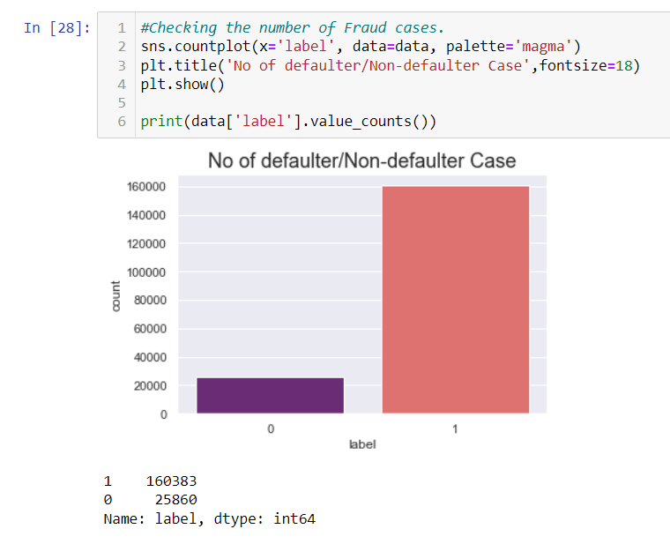
univariate analysis
After seeing the label column which is also our target feature for this dataset it is clearly shown that 86.11% of data is label 1 and only 13.8% of data is label 0 so our dataset is implanced. So before making the ML model first we have to do sampling to get rid off imblance dataset.

Slide 8
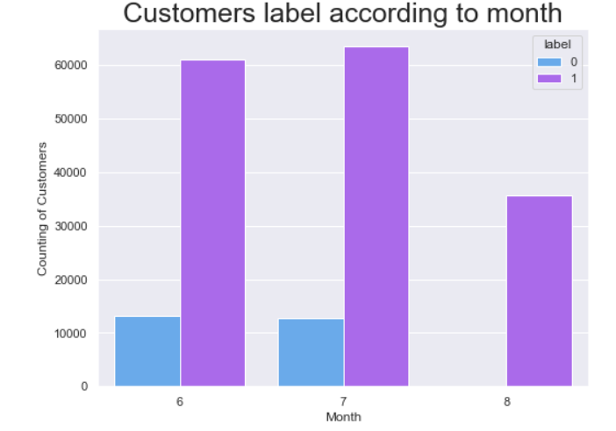
univariate analysis
The first figure which is date vs label shows that the customers who did not pay their loans are from date 10 to 23. There are severals customers at June and July month who did not pay their loan.

Slide 9
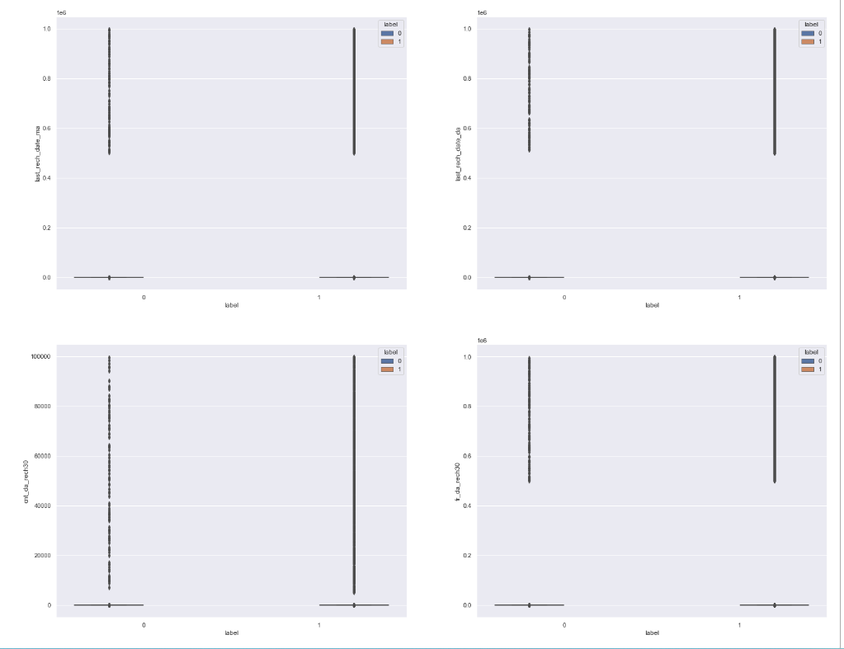
Spotting Outliers
There are too many outliers present in our dataset . So we need to remove it. But before removing please check that only 8 to 10% of data removed.

Slide 10
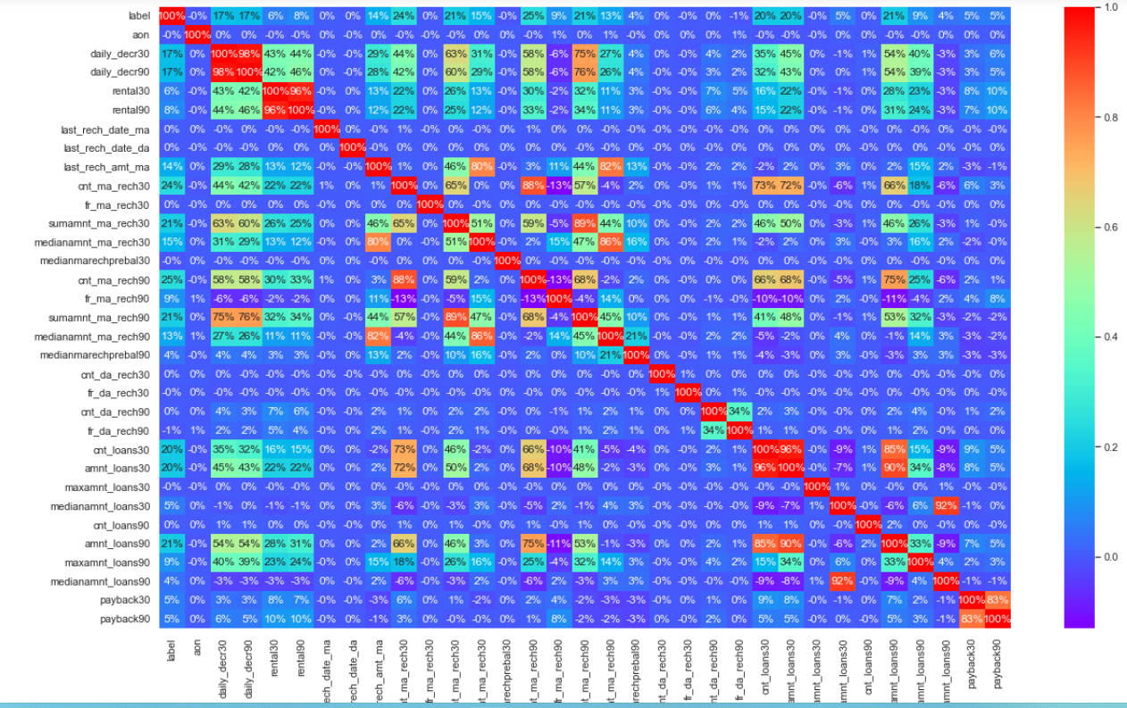
Correlation

Slide 11
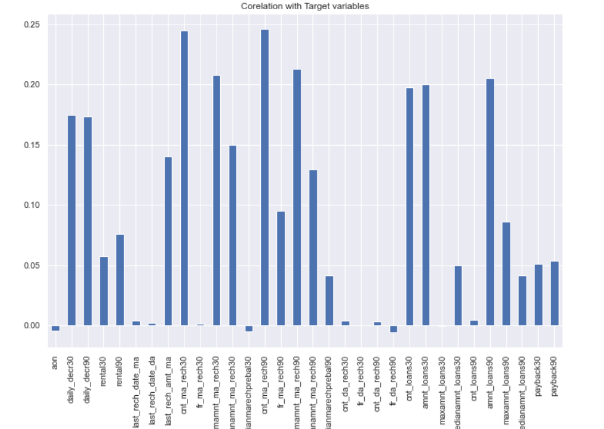
Observing Correlation
Daily_decr30 and daily_decr90 features are highly correlated with each other.
Rental30 and rental90 features are highly correlated with each other.
Cnt_loans30 and amount_loans30 columns are highly correlated with each other.
Amount_loans30 is also highly correlated with amount_loans90 column.
Medianamnt_loans30 and medianamnt_loans90 is highly correlated with each other.
We have to drop one of the features which are highly correlated with other features. And if we don’t do this then our model will face multi-colinearity problem.

Slide 12
Model/s Development and Evaluation

Slide 13

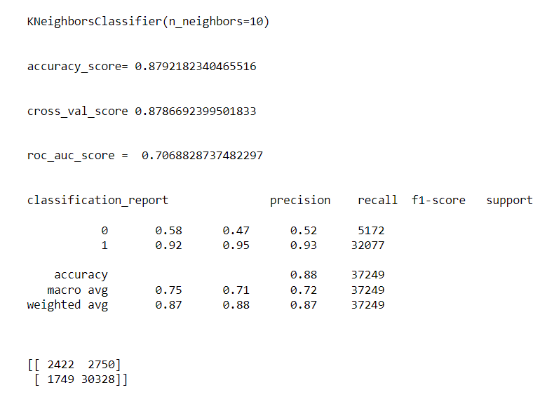
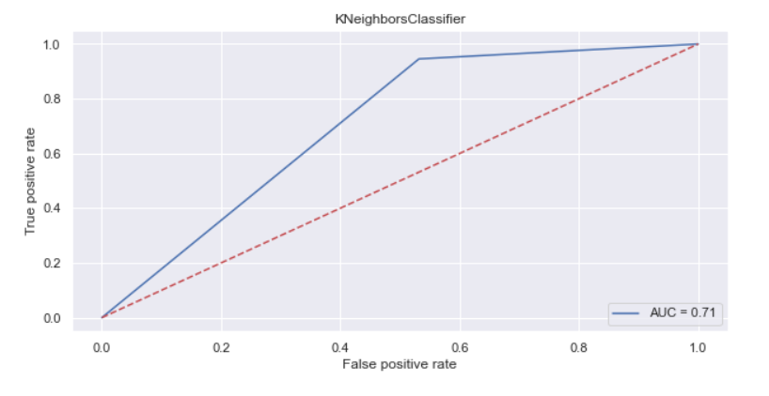
K Neighbors Classifier

Slide 14
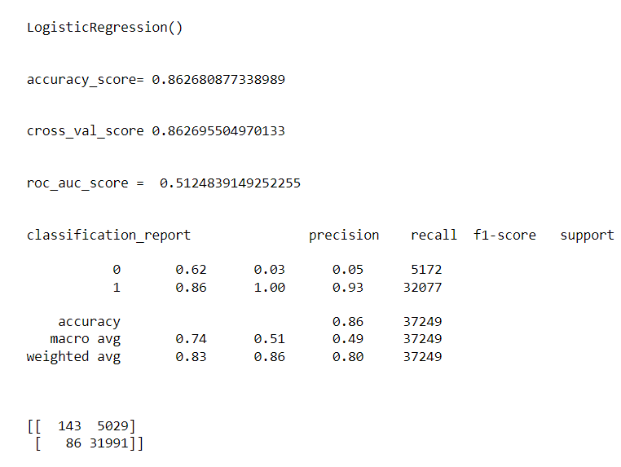
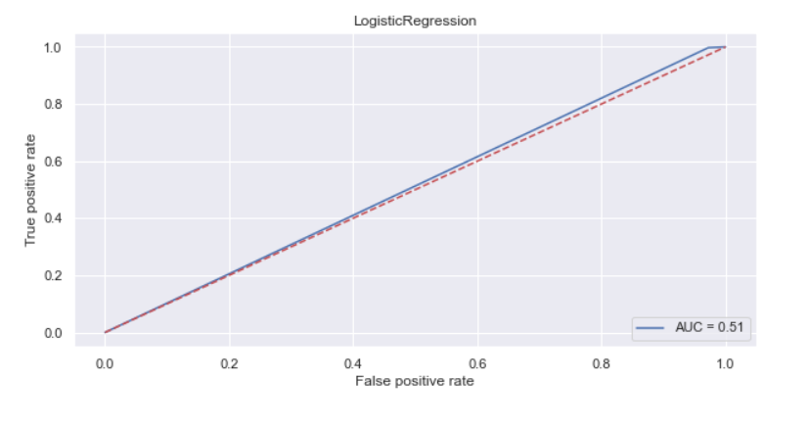
Logistic Regression

Slide 15
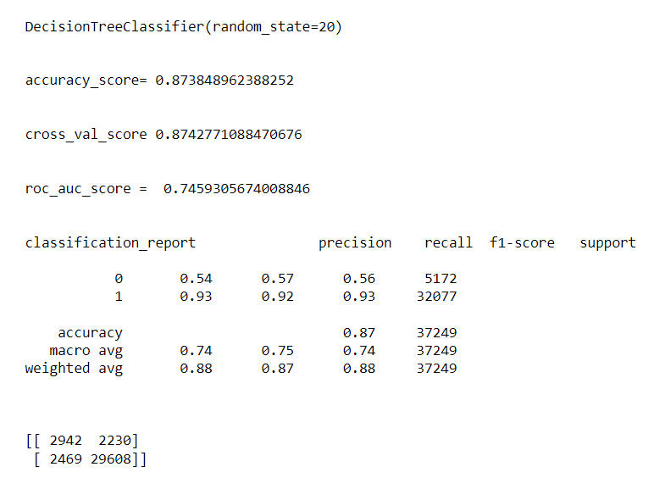
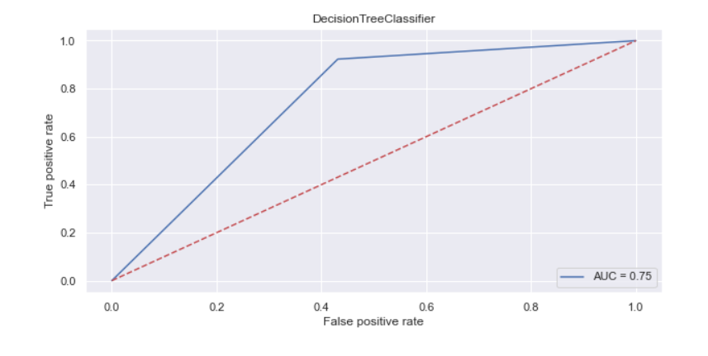
Decision Tree Classifier

Slide 16
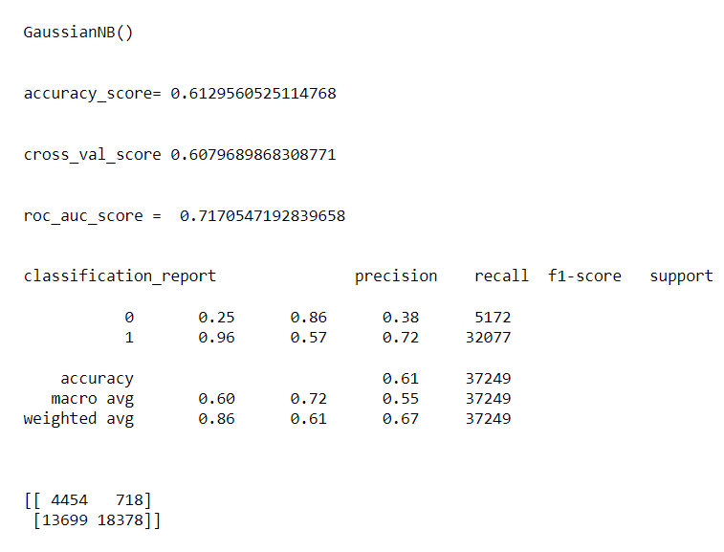
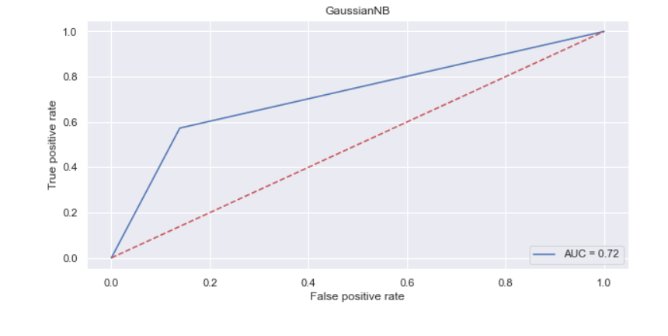
Gaussian N B

Slide 17
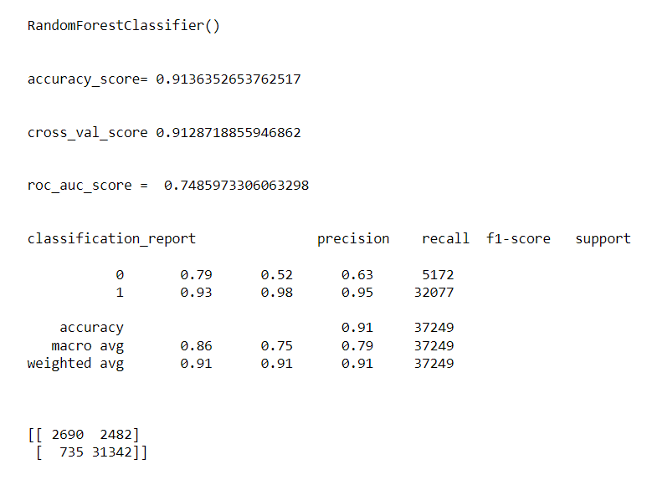
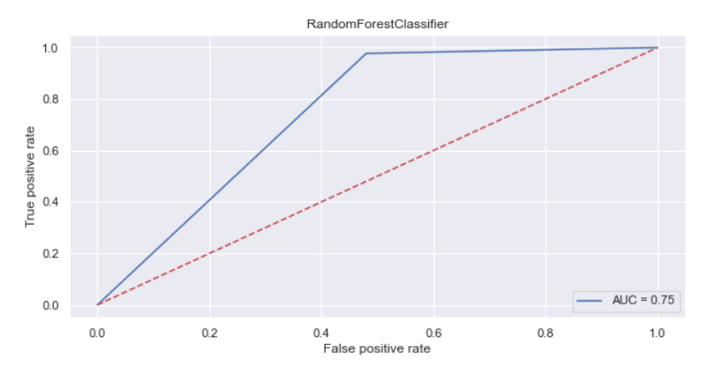
Random Forest Classifier

Slide 18
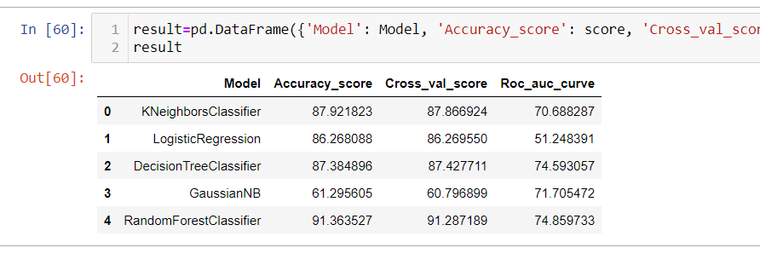
Conclusion
As I load the dataset I found the data is quite imbalanced and, first thing I found that the age of users in negative count of days so I replaced with 0, then I settled parameters to 130 days for the users who is doing there recharge. Then I found that the company is giving the loan only Rupiah 6 and Rupiah 12 so I have set the parameters and found that 1047 data that is showing more amount of loan which is not possible so instead of replacing the data with most frequent data I just dropped those entire data. Then as I was exploring the defaulter’s data found that the users are valuable to our clients but somehow they failed to pay the loan within time frame, so I visualized them individually. As I described earlier that the most number of loan amount is rupiah 6 so which means the users want less amount of loan instead of big amount, hence the client must focus on less amount of loan. The early users or I can say the users who take less number of loans they are more defaulters so the client must be strict to those users. As the data was skewed left from its axis so I used sqrt transformation 3 to reduce down the skewness of data, then I removed the outliers using zscore. Then finally I have prepared the cleaned data for model buildings.

Slide 19

Slide title 29

